Slide 1

Dementia Risk Detection with Deep Neural Networks
By Danai-Georgia Sakelliadou and Shivani Hegde
CAS CS 523 Deep Learning
Professor Sang Chin
Boston University

Slide 2
Overview
Motivation
Background
Methodology
Results
Conclusion and Outlook

Slide 3

Motivation
Alzheimer’s Disease comprises the most common cause of dementia (5.8 million people in the US as of 2020)
5th leading cause of death for people >65 years
It has a major economic cost to be treated
with the total healthcare costs being estimated at $305 billion(2020).
A cost expected to increase (~to $1 trillion) as the population ages.
Early diagnosis and treatment is our best bet!
MOTIVATION
BACKGROUND
METHODOLOGY
RESULTS
CONCLUSION AND OUTLOOK
https://www.cdc.gov/aging/aginginfo/alzheimers.html
https://pubmed.ncbi.nlm.nih.gov/32840331/

Slide 4
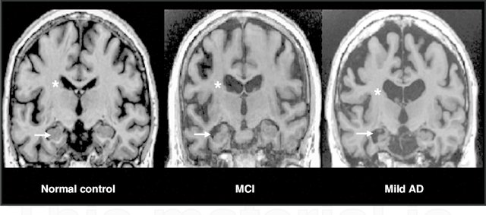
Alzheimer’s Disease
MRIs as a diagnostic tool for Alzheimer’s
Determining factors that aid early prediction of AD:
- Brain atrophy and tau protein
disposition visualisation
- genetic predisposition (APOE gene -
amyloid protein aggregates involved in
pathogenesis
MOTIVATION
BACKGROUND
METHODOLOGY
RESULTS
CONCLUSION AND OUTLOOK
MCI:Mild Cognitive Impairment(Intermediate phase)

Slide 5
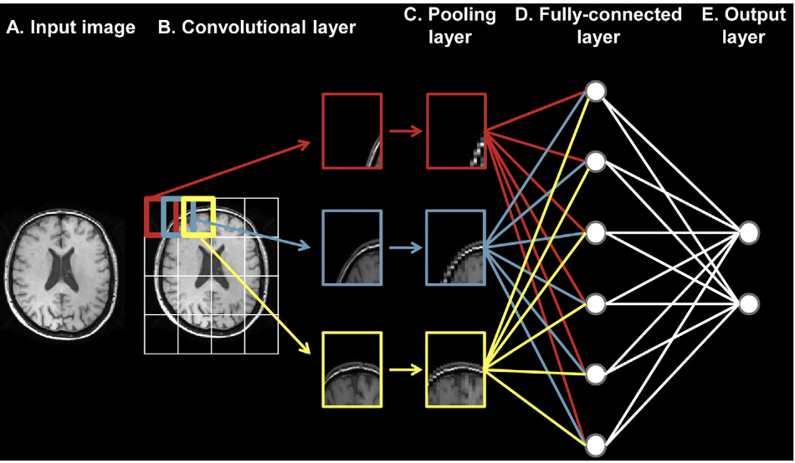
Proposed
Neural Network architecture
Convolutional Neural Network(CNN)
Why CNNs?
In the past, CNNs architectures have reached 99% accuracy in the AD vs Control classification problem.
CNNs give us the opportunity to use Transfer Learning, to use pretrained models(i.e AlexNet, ResNet) to speed up classification and increase efficiency.
More probable to deal well with unseen patient data.
MOTIVATION
BACKGROUND
METHODOLOGY
RESULTS
CONCLUSION AND OUTLOOK
Architecture of a typical CNN
https://www.sciencedirect.com/science/article/pii/S2213158218303930

Slide 6
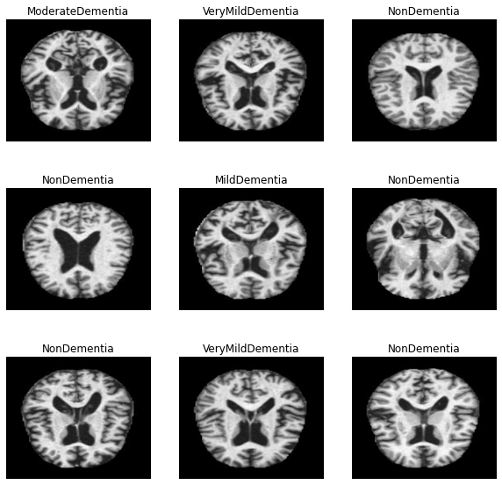
Neural Network Methodology
Kaggle Dataset (MRI .jpg images)
Modified Kaggle CNN Architecture (Tensorflow)
MOTIVATION
BACKGROUND
METHODOLOGY
RESULTS
CONCLUSION AND OUTLOOK
Kaggle CNN Architecture from:
https://www.kaggle.com/amyjang/alzheimer-mri-model-tensorflow-2-3-data-loading/data
Modifications inspired by:
https://academic.oup.com/brain/article/143/6/1920/5827821#205118444

Slide 7
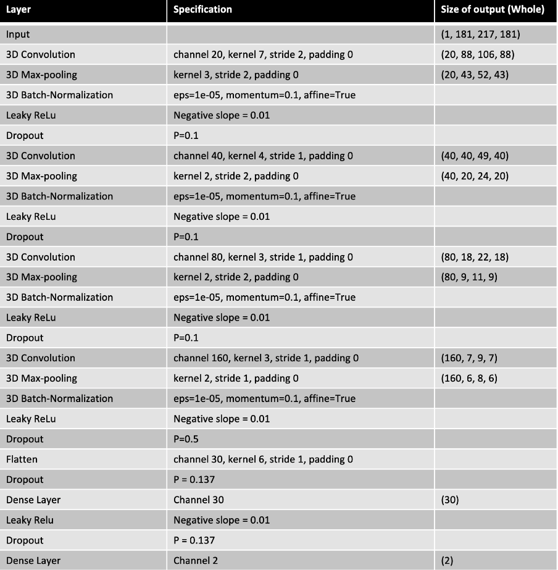
Custom CNN Neural Network Structure
2D Convolution (16 channel, 3 kernels, ReLu activ.)
+ Batch Normalization(w/ momentum)
2D Max Pooling
+ Leaky ReLu (negative slope coeff. alpha = 0.01)
+ Dropout (rate = 20%)
x 3
Convolution Block (32 x 32 filters)
Convolution Block (64 x 64 filters)
Convolution Block (128 x 128 filters)
Dropout (rate = 20%)
Convolution Block (256 x 256 filters)
Dropout (rate = 20%)
Flatten
Dense Block (512 dim, Dropout = 70%)
Dense Block (128 dim, Dropout = 50%)
Dense Block (64 dim, Dropout = 30%)
Dense (Softmax activation, 4 outputs)
https://academic.oup.com/brain/article/143/6/1920/5827821#205118444

Slide 8
Performance of Custom CNN vs. AlexNet
Custom CNN Model:
Test Loss: 0.8208
Test AUC: 0.8742
AlexNet Model:
Test Loss: 1.0365
Test AUC: 0.7796
MOTIVATION
BACKGROUND
METHODOLOGY
RESULTS
CONCLUSION AND OUTLOOK

Slide 9
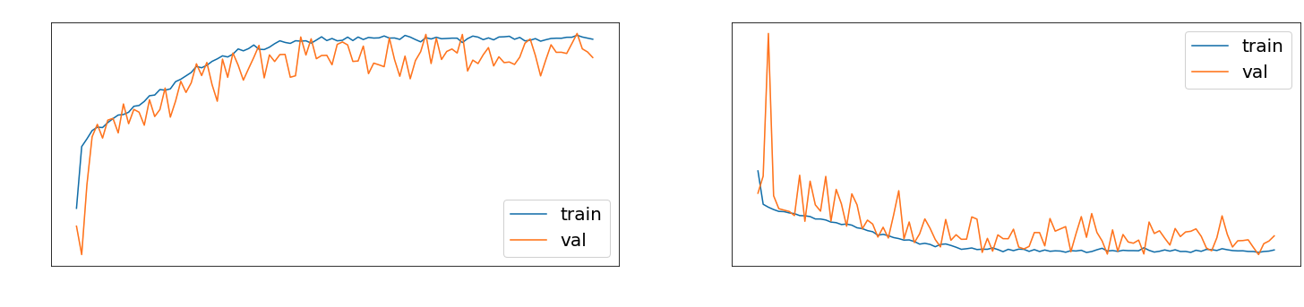
Training Graphs for Custom CNN Model (momentum=0.6, initial LR=0.01)

Slide 10
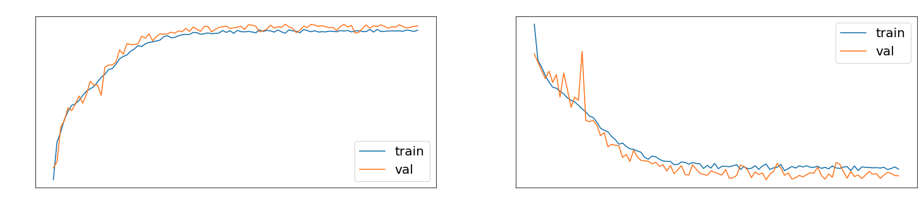
Training Graphs for Custom CNN Model (momentum=0.7, initial LR=0.003)

Slide 11
Conclusion and Outlook
Improve
Choosing the datasets we train upon more carefully
Using both MRIs and electronic health records as well as genetic data in our network
MOTIVATION
BACKGROUND
METHODOLOGY
RESULTS
CONCLUSION AND OUTLOOK

Slide 12
Future implementations
Increasing the variance of our input data type:
1.(BU Kolachalama Laboratory): MRIs + clinical data (e.g. cognitive assessment tests)
https://academic.oup.com/brain/article/143/6/1920/5827821
2. NLP: ConvLSTM to detect the cognitive and speech limitations through conversational transcripts
https://www.frontiersin.org/articles/10.3389/fnagi.2021.623607/full
3. GPS driving as a potential digital biomarker
https://alzres.biomedcentral.com/articles/10.1186/s13195-021-00852-1
4. Combining our model with the model proposed for the PD Dream Challenge- https://www.synapse.org/#!Synapse:syn10922704/wiki/471154 (or Conv1DNet to process input from accelerometers) - to create a differential diagnosis model for AD vs PD dementia.

Slide 13
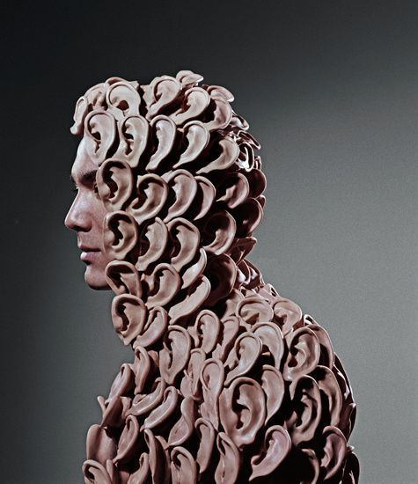
Thank you for your time!
Hope this was...unforgettable!
Questions??
“We’re all ears!”

